Slide 1


Frontend: Programming in Angular August 2024 Angular.dev
SOLIDT HÅNDVÆRK GENNEM METODIK

Slide 2
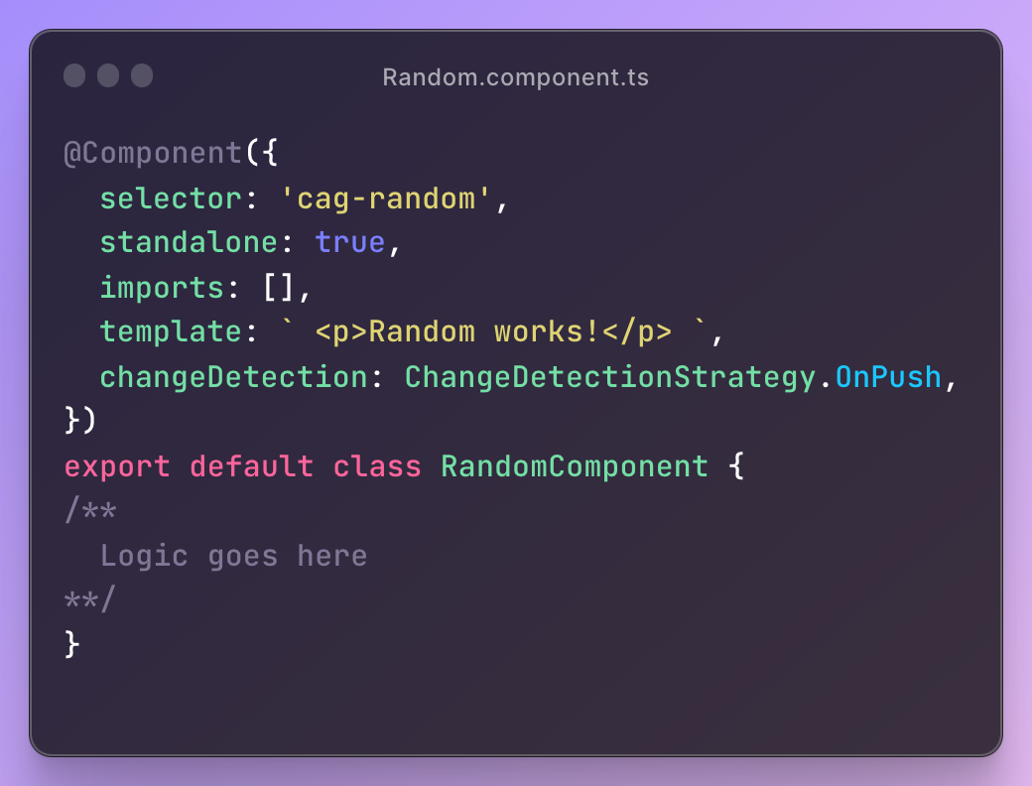
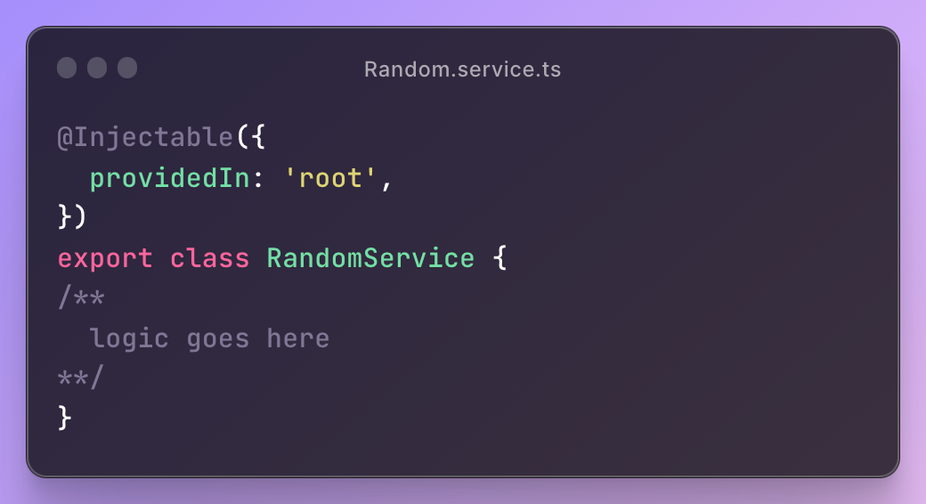
Component & Service

Slide 3
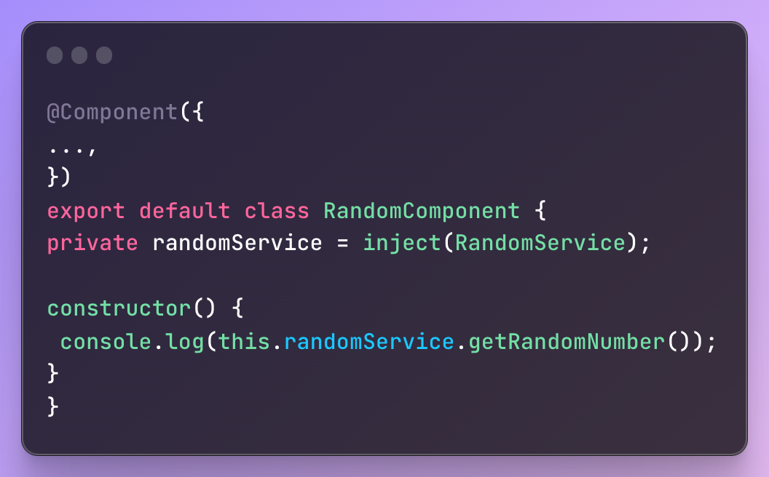
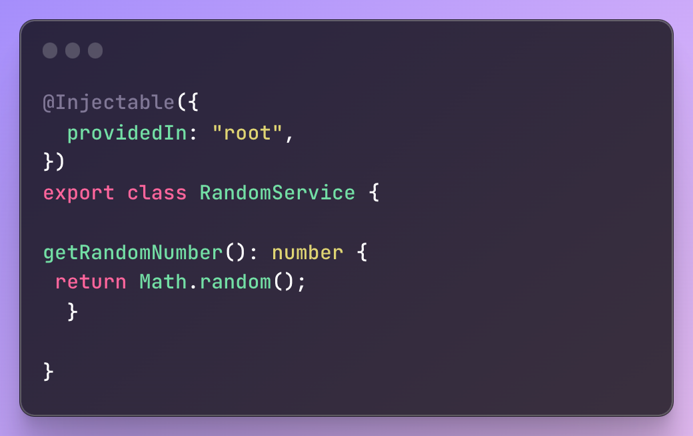
Dependency injection

Slide 4
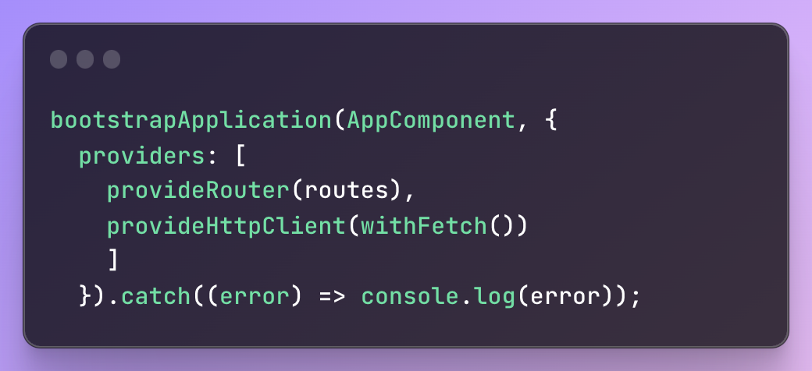
Dependency injection - 2

Slide 5
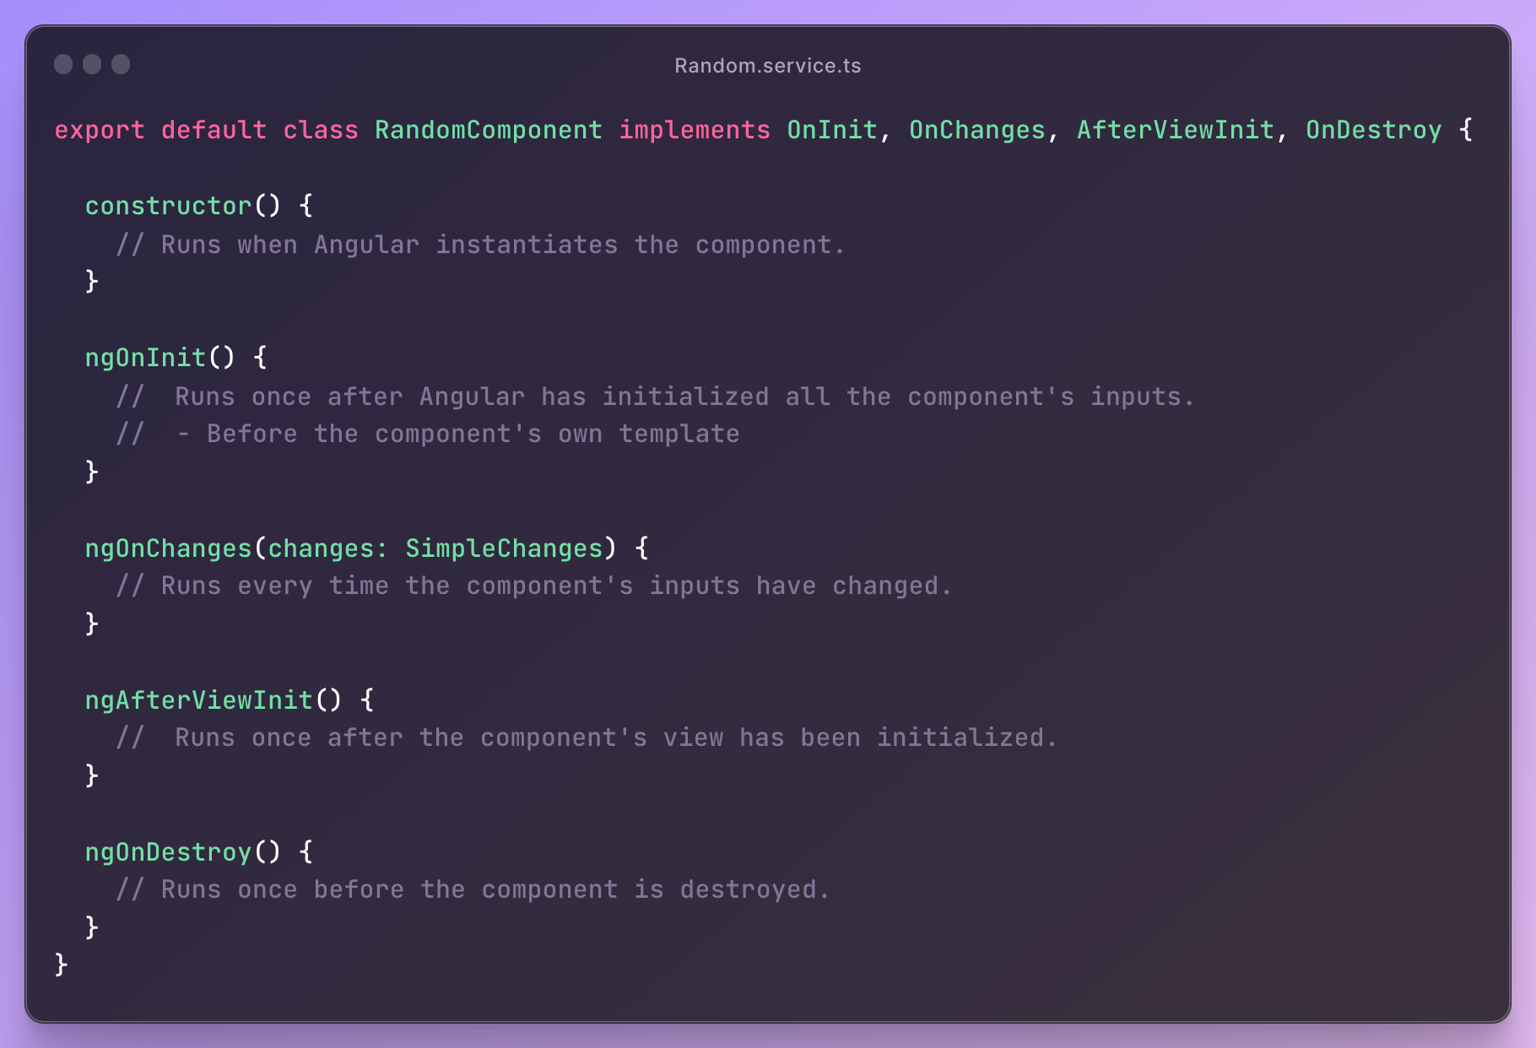
Component lifecycles

Slide 6
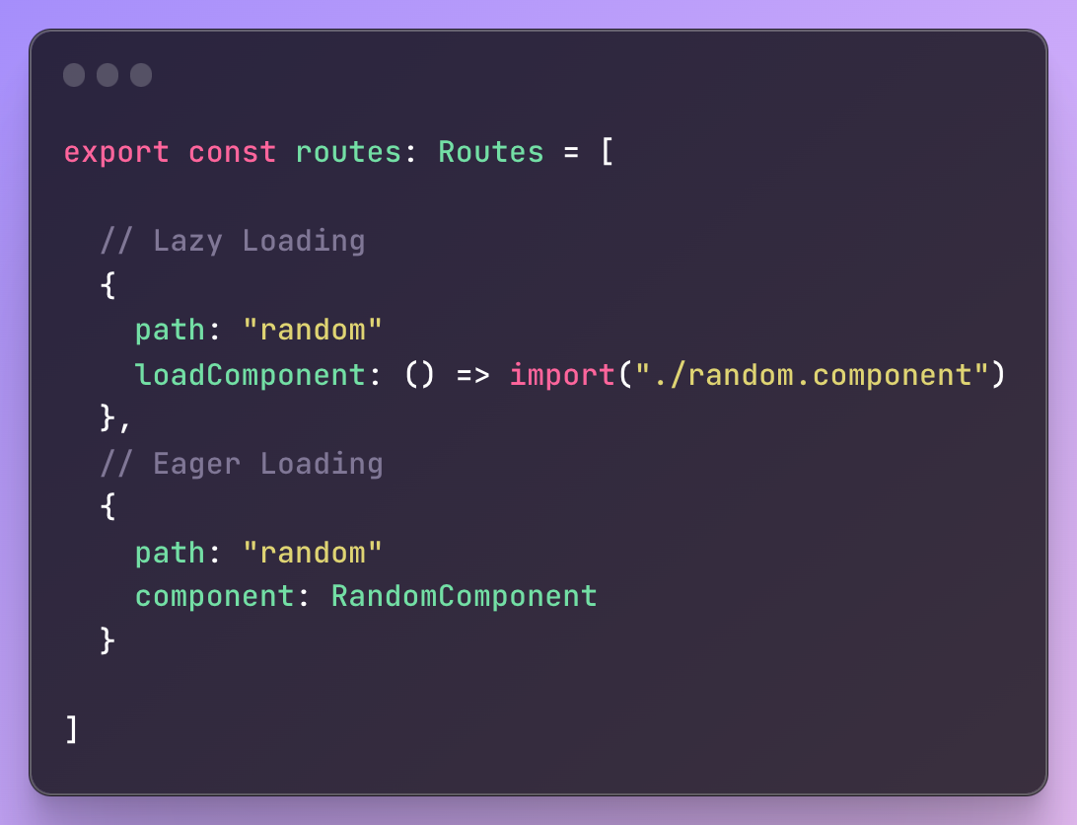
Routing

Slide 7
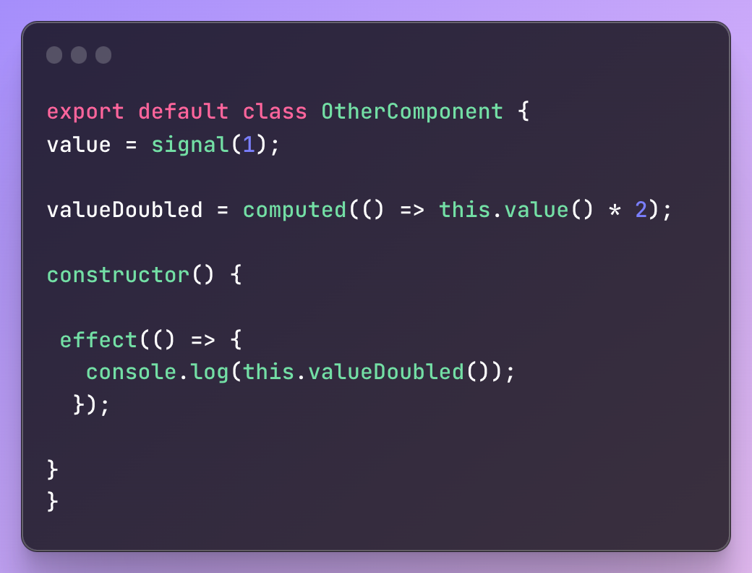

Signals

Slide 8
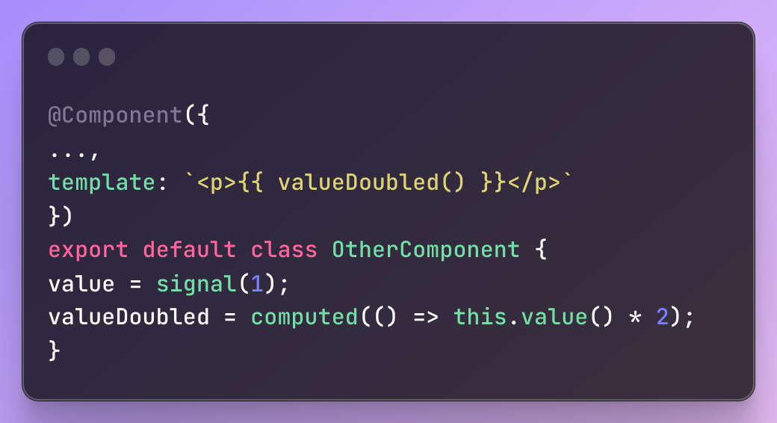
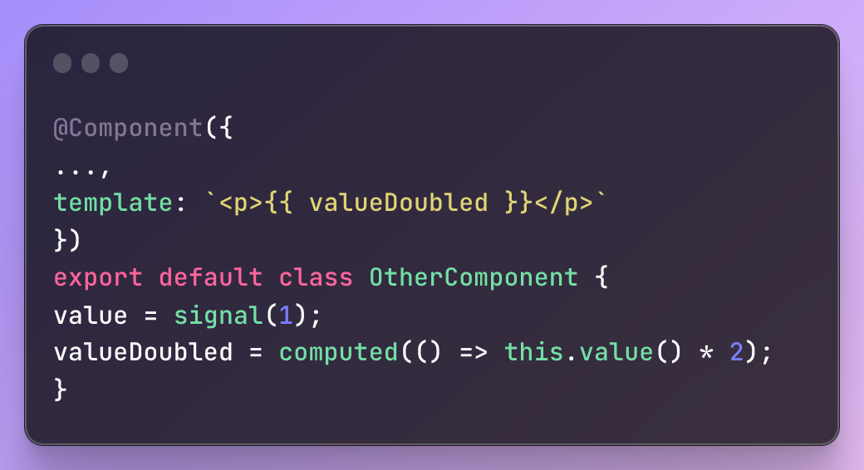
Using signals in template

Slide 9
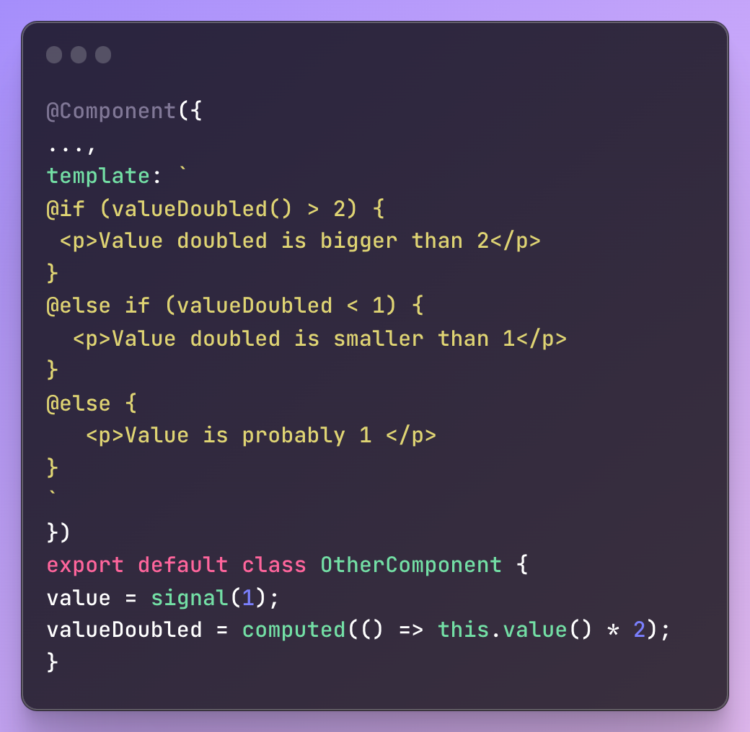
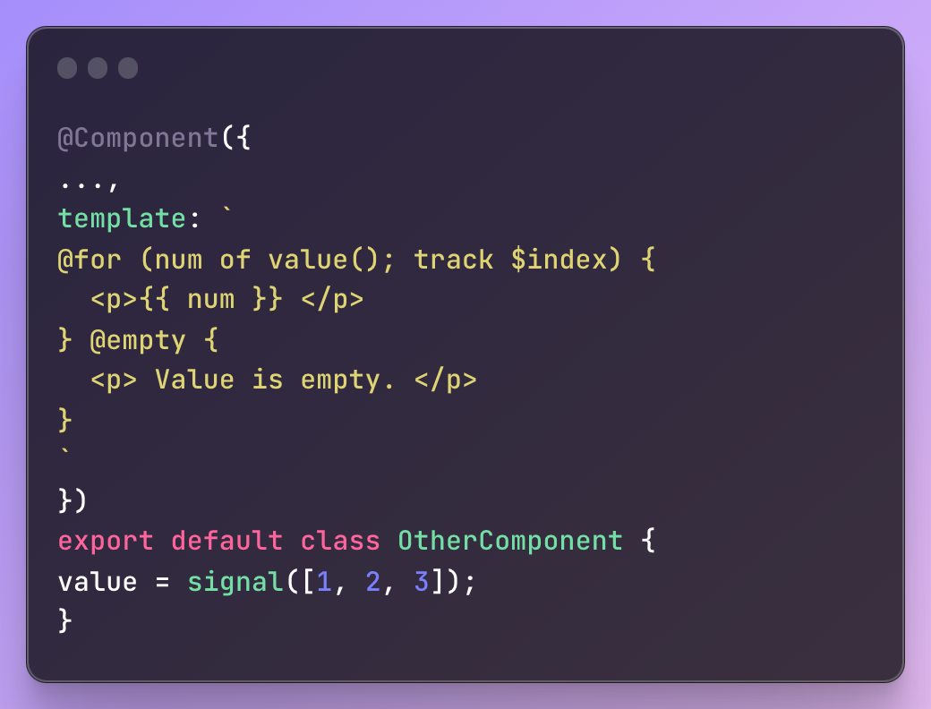
Control Flow

Slide 10
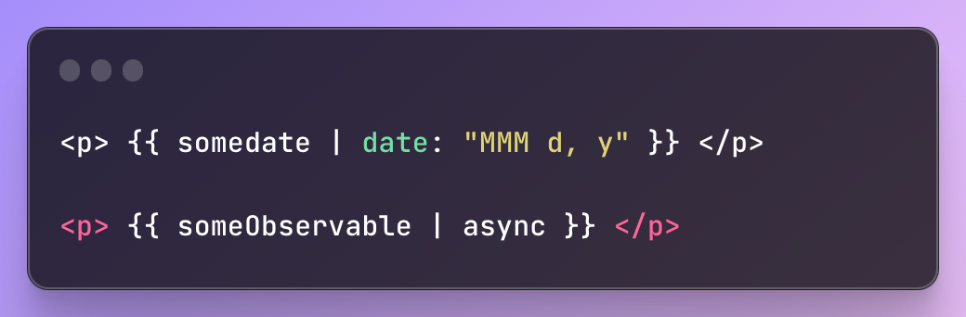
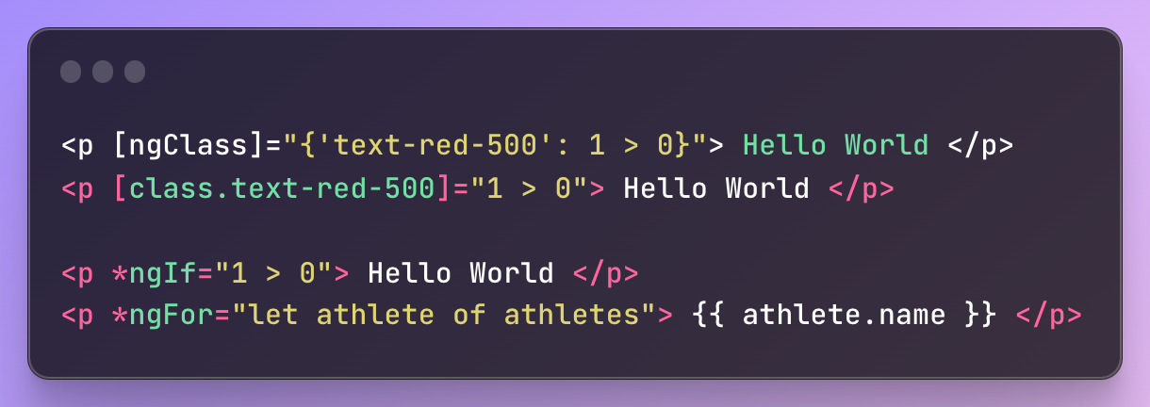
Pipes & directives

Slide 11
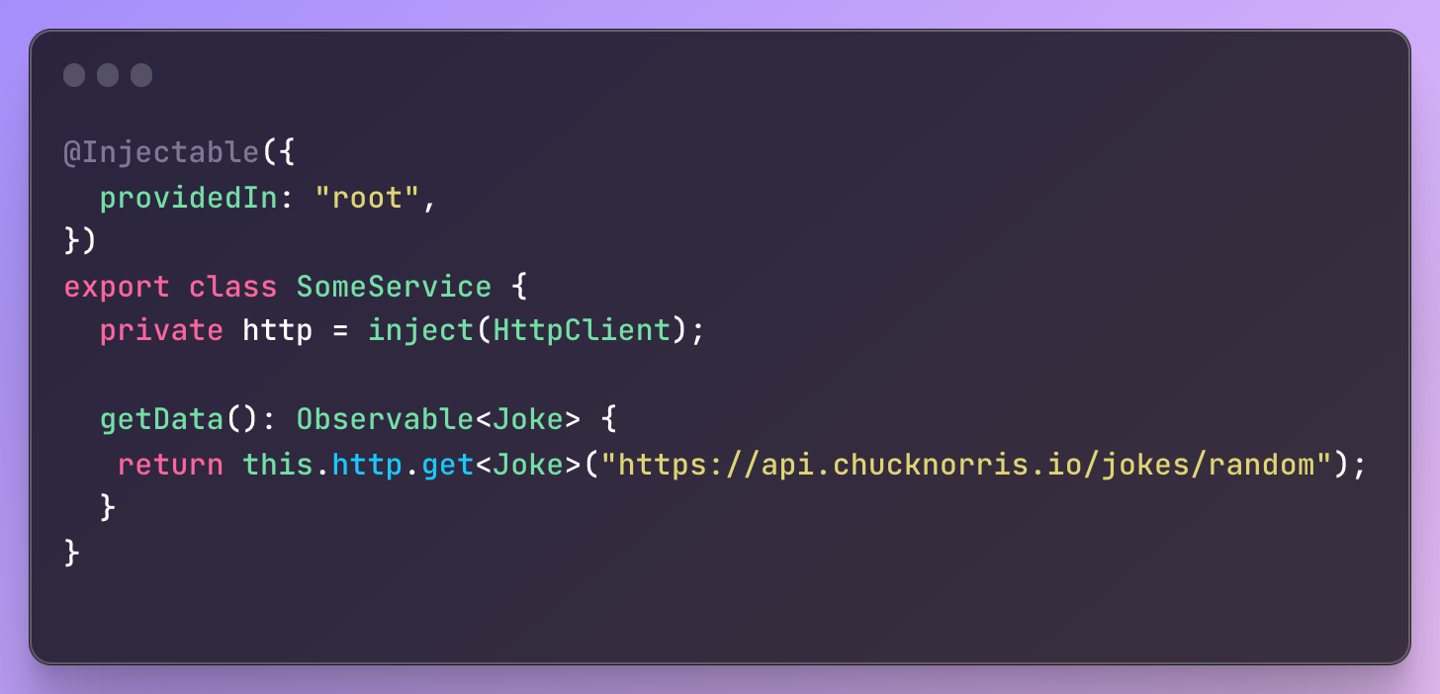
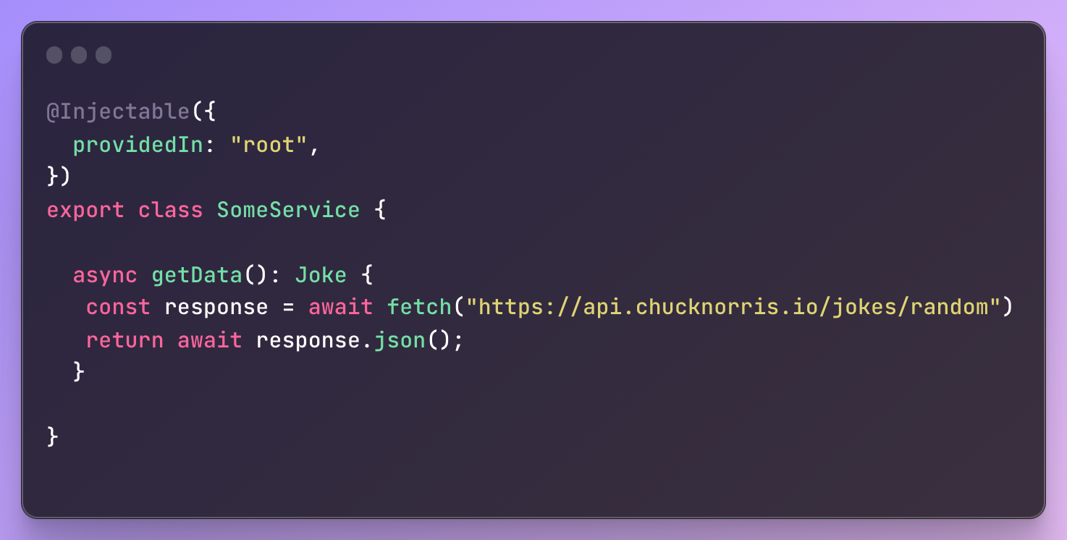
Making Http requests

Slide 12
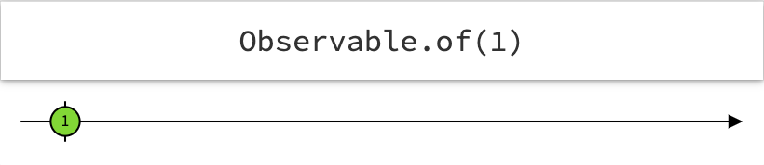
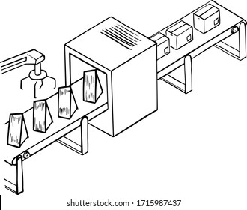
Observable (async)

Slide 13
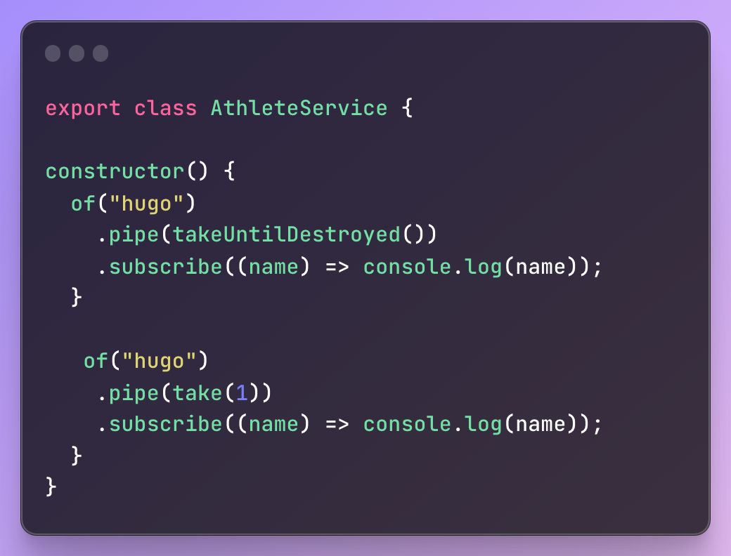
Subscriptions

Slide 14

RXJS Operators
map
tap
switchMap
take
debounceTime
https://rxmarbles.com/#map

Slide 15
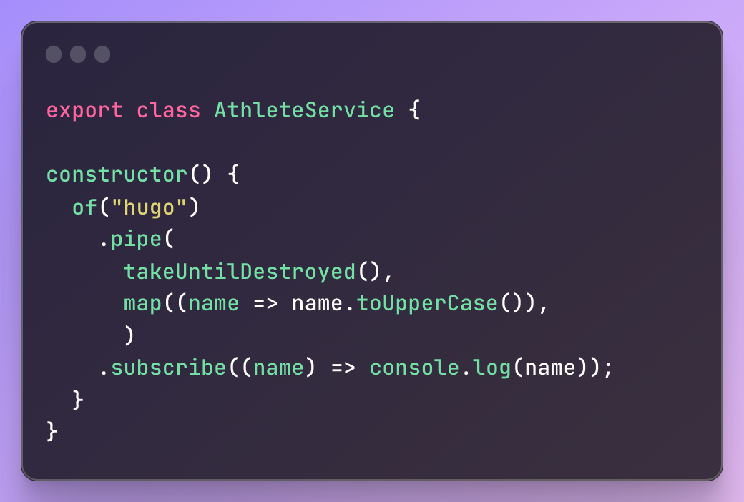
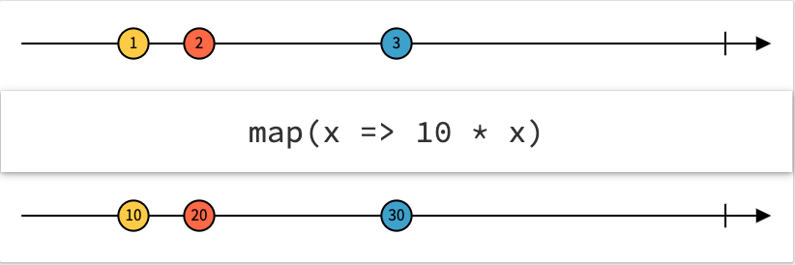
Map
Just like javascript’s own array function map

Slide 16
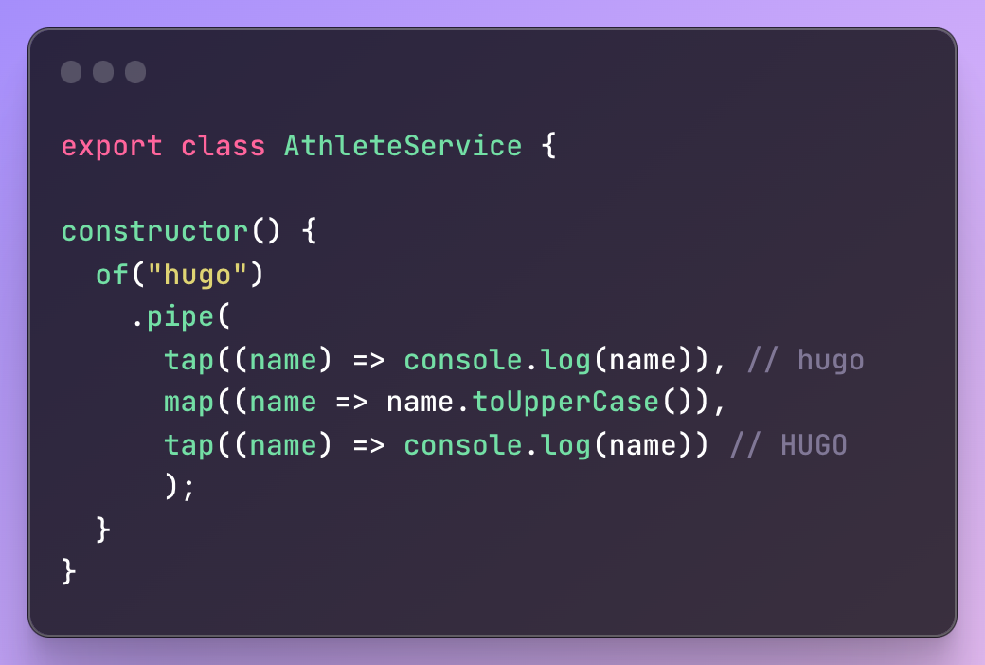
tap

Slide 17
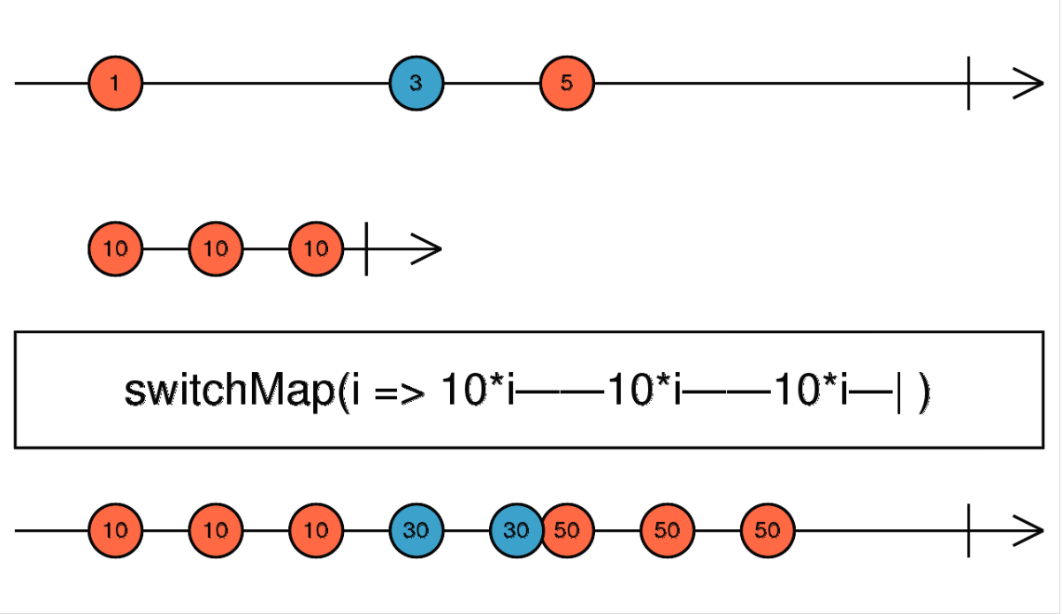
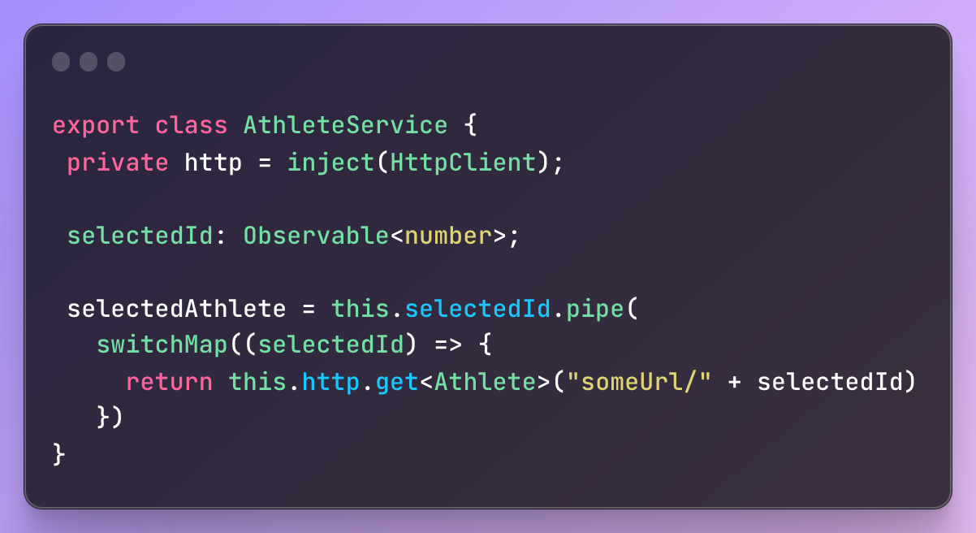
switchmap

Slide 18
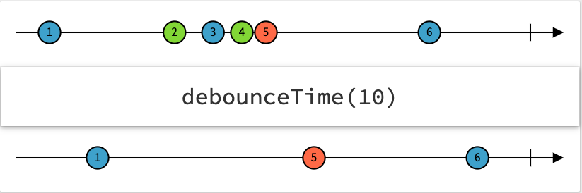
Debouncetime

Slide 19
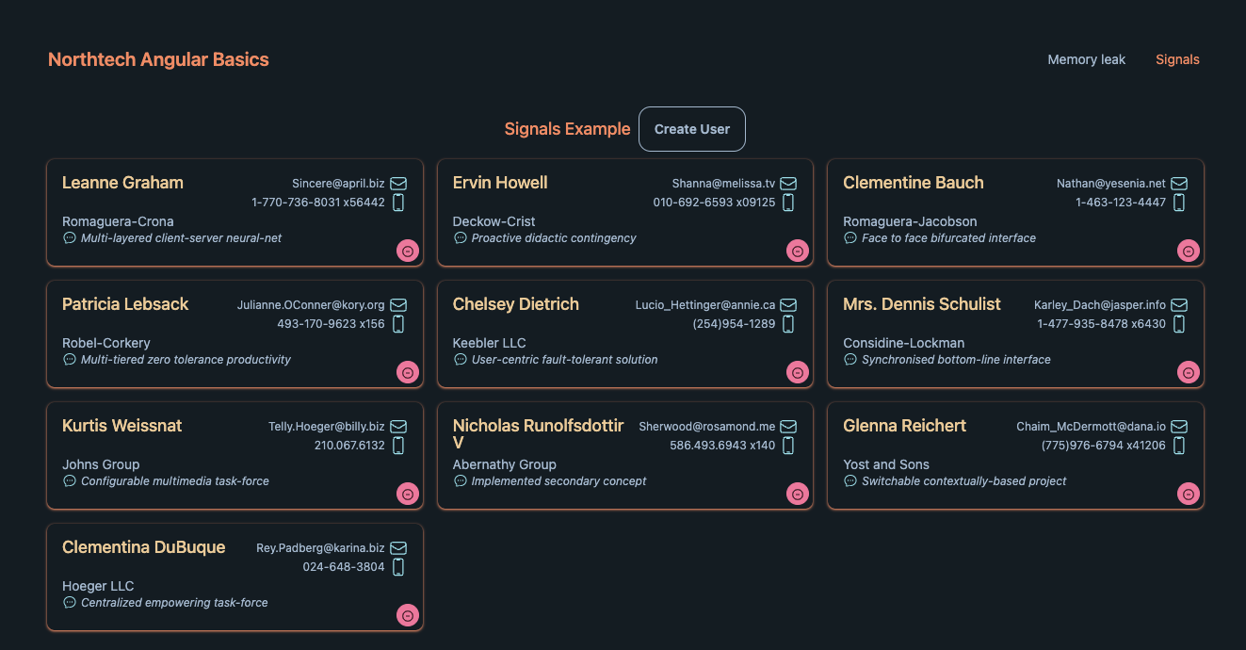
Demo og Q&a

Slide 20
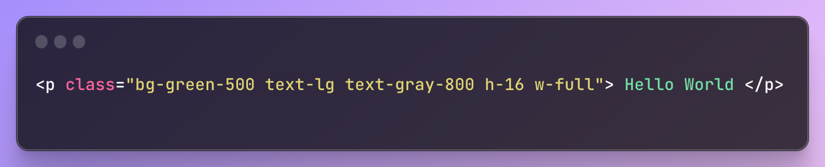
Styling - Tailwindcss
Unit = rem
1 rem = 16px;
1 unit = 0.25rem
h-16 = {height: 4rem / 64px}

Slide 21
One liners
(sudo) npm install –g @angular/cli
npx @angular/cli new “NAME” —minimal —defaults
npm i -D tailwindcss postcss autoprefixer
npx tailwindcss init
npm i -D prettier-plugin-tailwindcss prettier-plugin-organize-imports prettier

Slide 22
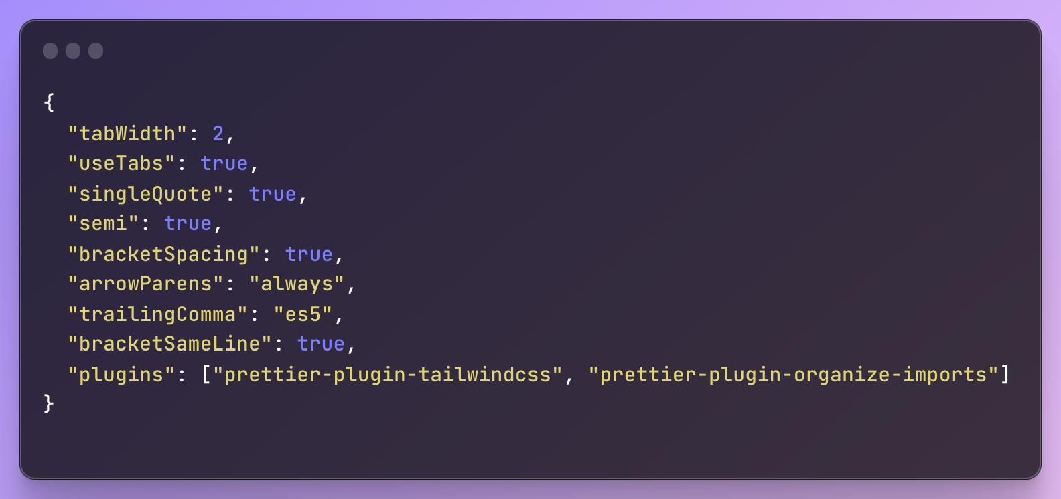
.prettierrc

Slide 23
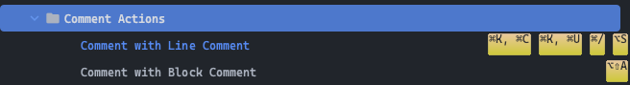
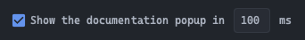
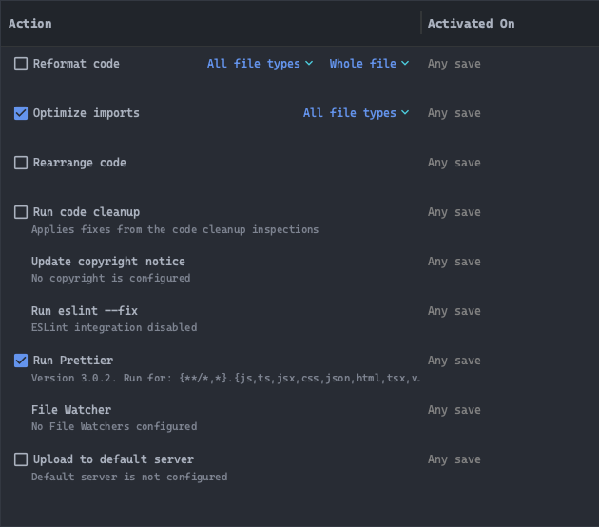
IDE / Webstorm settings
Keybinds
Documentation popup
Actions on save
Plugins
Rainbow Brackets
Theme (Poimandres)

Slide 24
Projekt Idéer
App Ideas
Todo list
Memory game (with pokemons)
Pokemon lookup
Picture Carousel (with randomized pictures)
Movie Watch List
Weather app
API
PokeApi: https://pokeapi.co/
TheMovieDB: https://www.themoviedb.org/
WeatherApi: https://www.weatherapi.com/
https://randomuser.me/

